Slide 1
NSLS II Physics Application and its Open Architecture
Guobao Shen
Controls Group, Photon Sciences
Brookhaven National Laboratory
Oct 23rd, 2014

Slide 2
Motivation
Traditional high level application suites
Closed environment
Self consistent
Come with its own simulation code
Work good once successfully configured
Expertise needed
Open structure environment
Break into separate modules
Portability
Reusability

Slide 3
System Architecture
3-tier open architecture at NSLS II
Python Apps
CA Client
MMLT
CA Client
XAL
CA Client
SDDS
CA Client
CS-Studio
CA Client
Ethernet
EPICS V4
MASAR
Python
PVAS
HTTP/REST
MUNICONV
Python
PVAS
HTTP/REST
Lattice/Model
Python
PVAS
HTTP/REST
IDODS
Python
PVAS
HTTP/REST
AI DS
Python
SQLite/MongoDB
MySQL
MySQL
MySQL
MySQL
Distributed Front-Ends
IOC
Dispersion Meas
IOC
Live MUNICONV
IOC
Orbit Correction
IOC
HW
IOC
JMS virtual accelerator
IOC
Live Optics
IOC
HW
IOC
HW
IOC
HW
IOC
HW
…
…
Tracy-III/Elegant
Tracy-III/Elegant

Slide 4
Middle Layer Services
Python Apps
CAC PVAC REST
MMLT
CAC PVAC REST
Matlab Apps
CAC PVAC REST
Channel Arch
CAC PVAC REST
CS-Studio
CAC PVAC REST
Ethernet
EPICS V4
MASAR
Python
PVAS
HTTP/REST
MUNICONV
Python
PVAS
HTTP/REST
Lattice/Model
Python
PVAS
HTTP/REST
IDODS
Python
PVAS
HTTP/REST
AI DS
Python
SQLite/MongoDB
MySQL
MySQL
MySQL
MySQL
Distributed Front-Ends
IOC
Live Optics
IOC
Live MUNICONV
IOC
Orbit Correction
IOC
Dispersion Meas
…
IOC
JMS virtual accelerator
Tracy-III/Elegant
Tracy-III/Elegant

Slide 5
Middle Layer Services
MASAR
A save/restore tool
Machine Snapshot, Archiving, and Retrieve
EPICS V4 Service to snapshot machines
General purpose tool
Globally handle PVs distributed in different IOCs
Machine
A collection of EPICS PVs
Snapshot
Data at specific time point
Value, time stamp, connection status, alarm status, alarm severity
Similar, but different purpose tools
Autosave
Single IOC bumpless rebooting
Channel Archiver
Archive periodically
Save time serially data

Slide 6
Middle Layer Services
MASAR Architecture
CS-Studio/BOY
Others
(Matlab)
PyQt
Scripting
MASAR Client Python Library pvAccess Client
pvAccess Client Library (Java)
pvAccess
MASAR Server (EPICS V4 Engine)
DSL-PY Module (C++ <->Python)
Gather/C++
PYMASAR (Python)
SQLite
Channel Access
MongoDB
MySQL
IOC
IOC
IOC
Restore
Finished
User Apps
Plan
Developing

Slide 7
Middle Layer Services
MASAR terminologies
Snapshot
pv
pv group
configuration
event
event data
...

Slide 8
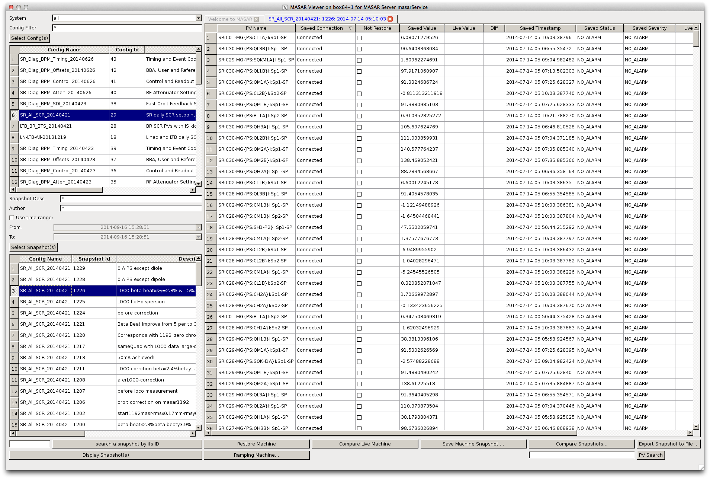
Middle Layer Services
MASAR Client PyQt4 UI
Become official lattice ID in our commissioning reports, olog, …
Notes:
User select data set to be compared
Select reference data set from a pop up dialog
By default, first selected data as reference set

Slide 9
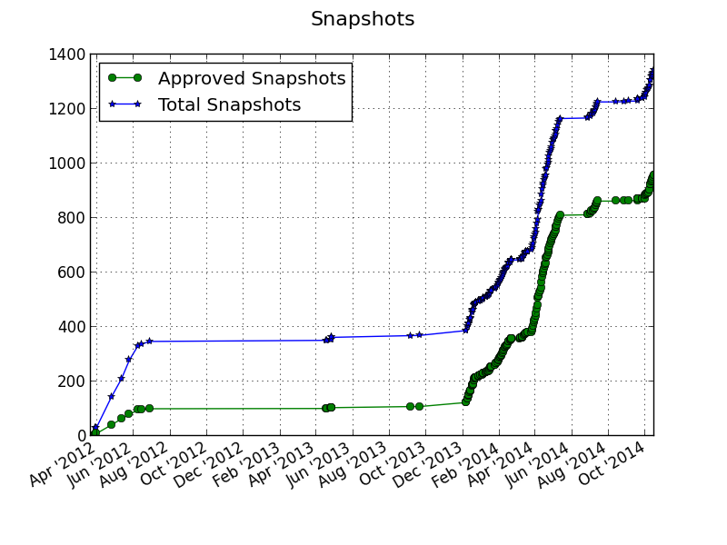
Middle Layer Services
Deployed in control network from the first day (3/27/2012)
MASAR snapshots taken with time (up to 10/15/2014)

Slide 10
Middle Layer Services
RESTful based middle layer services
For static data
Data warehouse
Middle layer IOC for live data
In V3 currently, and planned to be in V4
Services at NSLS II
MUNICONV: multiple unit conversion
Lattice/Model
Beam based interlock data service
Insertion device data service

Slide 11
Middle Layer Services
Architecture for RESTful based Service
Scripting
CSS/BOY
Others
(Matlab)
Python Client
Java Client
Browsers
RESTful
pvAccess
RESTful
pvAccess
RESTful
pvAccess
V4 channelRPC service
HTML
Django Service
IOC
(Live Data)
Python Data API
Python-MySQLdb
MySQL
Finished
User Apps
Planning
Developing

Slide 12
Middle Layer Services
MUNICONV Service
Multiple unit conversion
First implementation targeting on magnets
Convert value between different unit systems
i: power supply current
b: magnetic fields
k: value in model/lattice domain
Implemented with Django
MySQL as RDB backend
Client support
Python library
Web UI

Slide 13
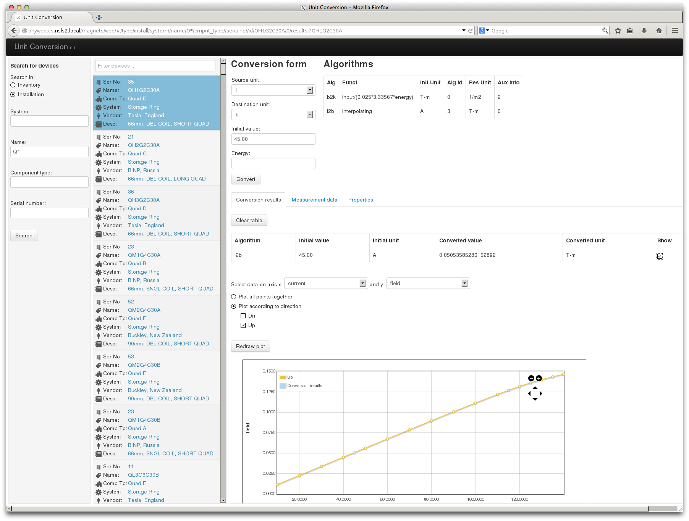
Middle Layer Services
MUNICONV WEB View

Slide 14
Middle Layer Services
MUNICONV IOC
pyDevSup: Python Device Support
Initialize IOC thru RESTful web service
Trigger processing when HW record processed
~ 1K HWs
~ 4K soft records
SP, RB
B, K values
1 HW PVs => 1 or more soft PVs
Power chain
Separate from H/W IOC
PV Mapping & relation thru C.F.
Hardware IOC
MUNICONV IOC
1:N
B PV
1:1
I PV_
I PV_
I PV_
K PV
I PV
1:N

Slide 15
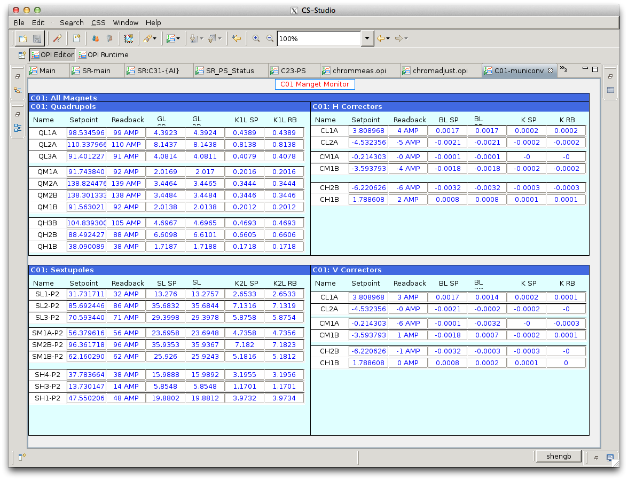
MUNICONV

Slide 16
Middle Layer Services
Lattice/Model Service
A further development based on our virtual accelerator
Consists of 2 parts
WEB service
Live IOC for online requirement
Support 2 simulation codes (Tracy-3 & Elegant)
Transparent switching between each other
Beam Parameter
Beam Parameter
Lattice Deck
Beam Parameter
Beam Parameter
Simulation/ Measurement
Lattice (Geometric + Strength)
Input
Model (Simulation result)
Output

Slide 17
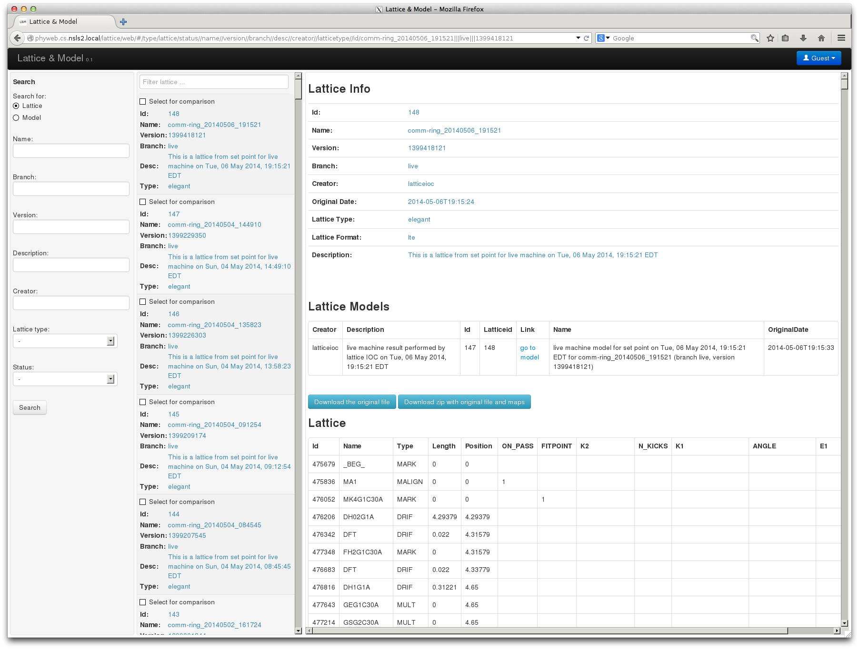
Middle Layer Services
Lattice view

Slide 18
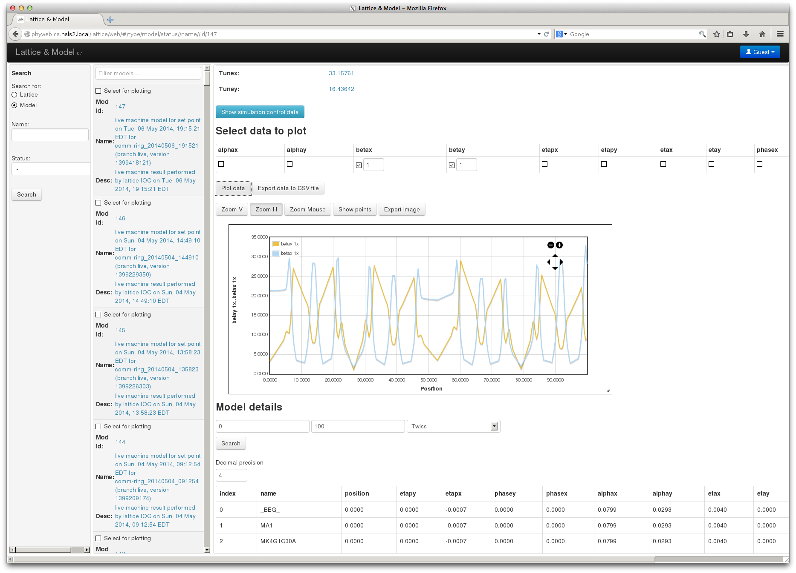
Middle Layer Services
Model view

Slide 19
Middle Layer Services
Lattice/Model IOC
On demand mode
CF to get all PVs
MUNICONV to get physics unit
Lattice/Model to produce result
WEB service to capture all history data
CS-Studio panel to present results
MUNICONV IOC
Lattice/Model IOC
Lattice/Model RESTful
I PV_
I PV_
Quad
K PV
PVs
Sext
K PV
Data Processing
Django Service
H/V Cor
K PV
Lattice Deck Generator
Simulator

Slide 20
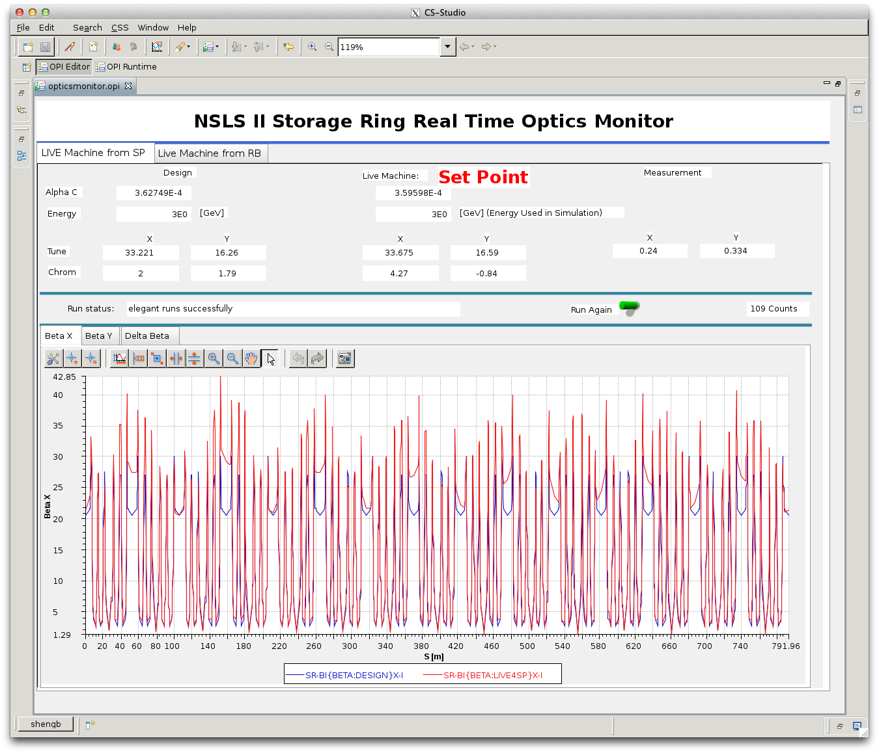
Middle Layer Services
Lattice/Model IOC CSS Panel

Slide 21
High Level Physics Applications
Python Apps
CAC PVAC REST
MMLT
CAC PVAC REST
Matlab Apps
CAC PVAC REST
Channel Arch
CAC PVAC REST
CS-Studio
CAC PVAC REST
Ethernet
EPICS V4
MASAR
Python
PVAS
HTTP/REST
MUNICONV
Python
PVAS
HTTP/REST
Lattice/Model
Python
PVAS
HTTP/REST
IDODS
Python
PVAS
HTTP/REST
AI DS
Python
SQLite/MongoDB
MySQL
MySQL
MySQL
MySQL
Distributed Front-Ends
IOC
Live Optics
IOC
Live MUNICONV
IOC
Orbit Correction
IOC
Dispersion Meas
…
IOC
JMS virtual accelerator
Tracy-III/Elegant
Tracy-III/Elegant

Slide 22
High Level Physics Applications
Architecture
CS-Studio/BOY
CS-Studio
EPICS V4 Java Client
User Apps
EPICS V3
IOC
EPICS V4
Python
EPICS Database
Accelerator Physics High Level App
(APHLA Library)
Finished
User Apps
Planning
Developing

Slide 23
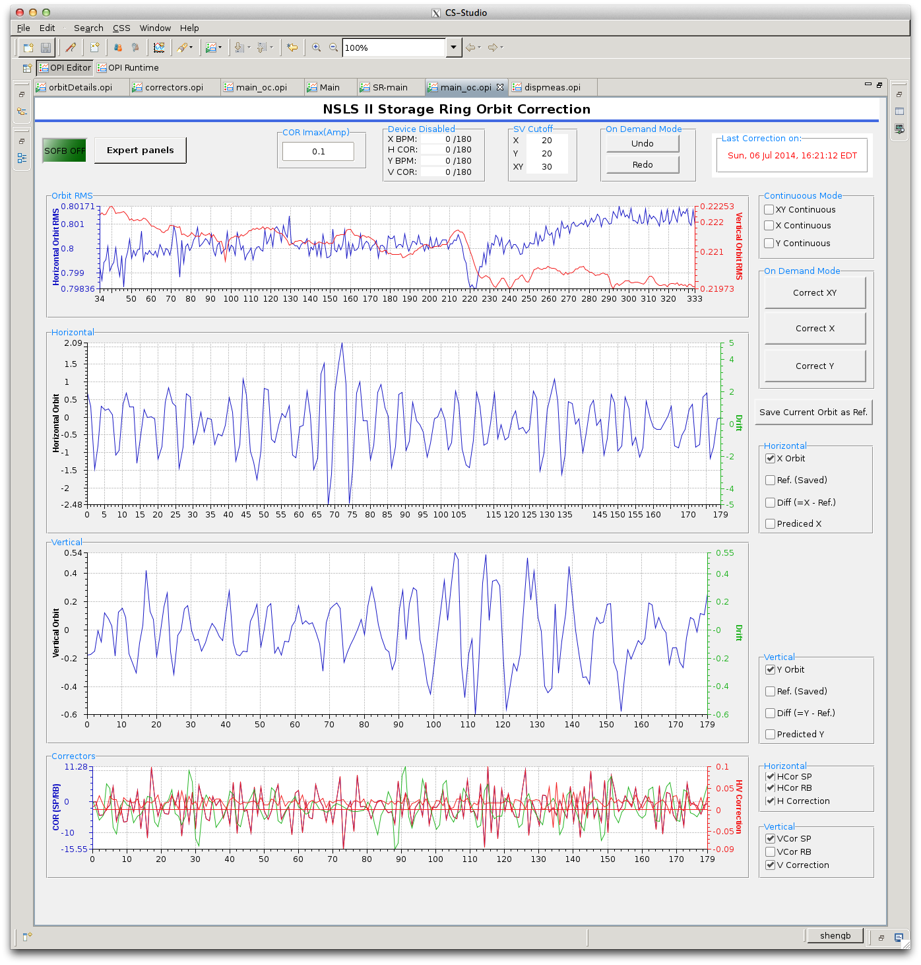
High Level Physics Applications
IOC as middle layer services
Orbit correction, dispersion measurement, chromaticity measurement/correction, local bump
beta function measurement + beta beat, tune correction, …
Orbit Correction
Use orbit response matrix
U, s, V = np.linalg.svd(m, full_matrices=True)
rcond = s[kwarg["nsv"] - 1] / s[0]
# solve for m*dk + (v0 - ref) = 0
dk, resids, rank, s = np.linalg.lstsq(m, -1.0 * v0, rcond=rcond)
k0 = np.array(ca.caget(kker), 'd')
if dImax is not None and np.max(np.abs(dk)) != 0.0:
dk = dk / np.max(np.abs(dk)) * np.abs(dImax)
...

Slide 24
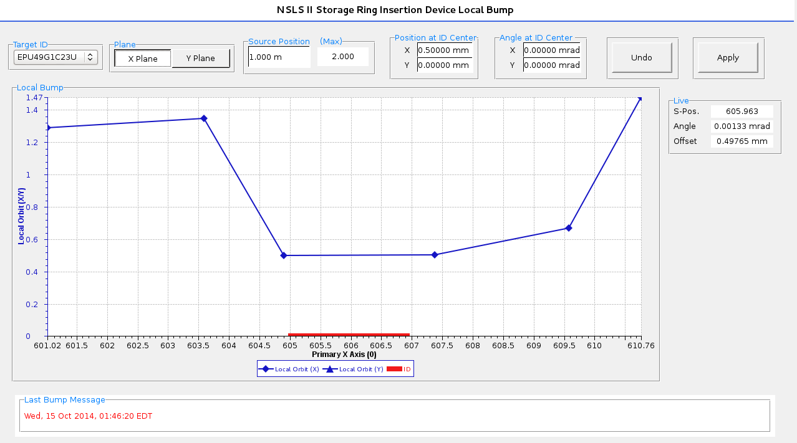
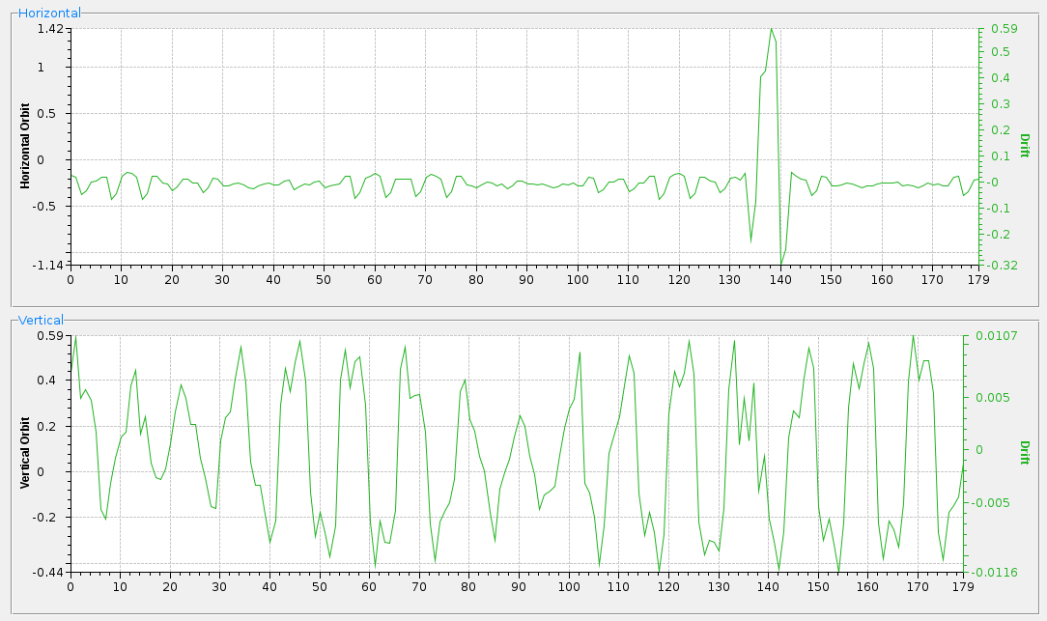
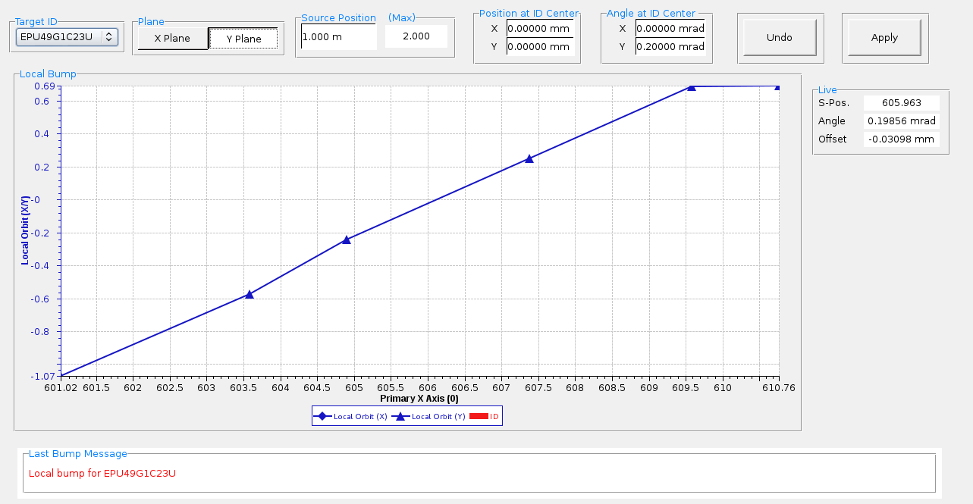
High Level Physics Applications
Local bump for insertion device
Adjust offset in X plane
Global orbit Difference display
Adjust angle in Y plane

Slide 25
System Integration
Client App
(PyQt, CS-Studio)
Olog
Channel Archiver
MASAR
Lattice/Model
Channel Finder
Lattice/Model
IOC
MUNICONV
IDODS
... IOC
MUNICONV
IOC
Orbit Correction IOC
Notes:
User create a MASAR configuration with PV from for example channel finder
Client apps could request MASAR to save a snapshot, or restore a particular snapshot
After restoring, MUNICONV IOC will got update simultaneously
MUNICONV IOC initialized with MUNICONV data service, and provides data in for example K value, which is available to client app
Operator/physicist could check restoring result by comparing machine optics, which available by lattice/model IOC
Result would be saved into lattice/model data service automatically, and displayed on CS-Studio panel for example
MASAR action will be logged into Olog
Lattice/model result is available thru web browser either

Slide 26
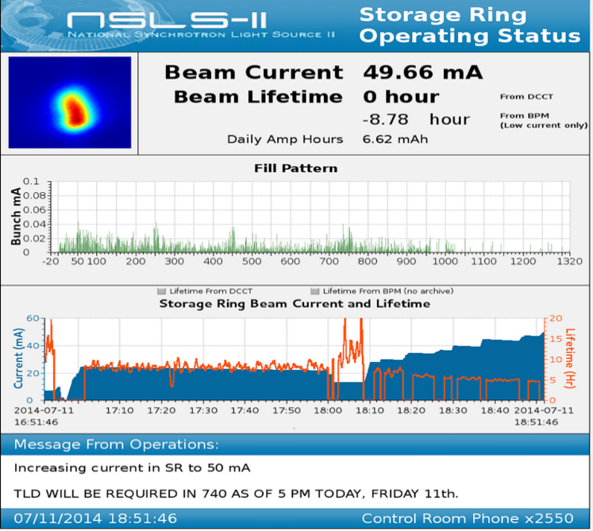
Conclusion
Major milestones
2013-11-27: beam commissioning started
2013-11-29: achieve 200 MeV
2013-12-07: injection into booster
2013-12-31: 3 GeV in booster
2014-03-26: storage ring commissioning started
2014-03-30: 1st turn around SR complete
2014-04-05: 25 mA!
2014-05-09: Near 100% injection efficiency
2014-07-11: 50 mA
2014-07-13: Phase I Commissioning complete
2014-09-22: Official approval for routine operations
2014-10-23: Expecting 1st light to beamline (10:30 EST) ?

